Slide 1
GNSS Measurement Engine: Communication Engineering Perspectives
Shu Wang, founder

Slide 2

Erlang network Brings a new dimension into GNSS positioning engineering
We combine professional grade satellite positioning, DSP & Big Data techniques together with cloud computing.
High-performance satellite positioning based on cloud computing is fundamental for IoT location based services
The salient features include:
instant response (cold start less than 1s),
improved accuracy (10x),
increased sensitivity (10x),
reduced BOM (40%),
higher power efficiency (90%),
OTA upgradable
And, of course, enhanced security and privacy.
Our technology can replace or be complementary to existing device-based GPS solutions.
All these are essential to and highly demanded by many 5G, logistic, IoT, children safety and senior care services

Slide 3
Several key GNSS Measurement Engine Design Parameters: Communication System Engineering Perspectives
Sensitivity and Link Budget
a signal processing perspective. Link budget and mutual coupling between receiver and transmitter
an information theory perspective. communication in low-SNR region.
Accuracy (Error) Budget
spatial channel models
Battery Life and Energy (Power) Budget
comprehensive energy modelling

Slide 4
Link budget and Examples: GPS, LTE and OTDOA
Parameter | GPS | LTE, 10MHz | LTE OTDOA | Comment
Transmitter Power | 44.3 dBm | typical 46 dBm | additional power boost
Transmitter Antenna Gain and Cable Loss | 10.2~12.3 dBi | 16 dBi
Target Propagation Path-Loss | 183 ~ 189.8 dB | e.g., 3GPP TS 25.996 modified COST231
Cochannel Interference Margin |  | 3 dB |  | Margin for inter-cell interference when the device is on the cell edge.
Fast Fading Margin |  | 4 dB |  | Typically it is set to be about 4 dB.
Antenna Efficiency |  | 4.7 dB
RFIC Noise Figure |  | 2.8 dB
Thermal Noise Floor |  | 107.3 dBm
Body Loss |  |  |  | usage model dependent

Slide 5
GNSS Measurement Engine Design: A Signal Processing Perspective
 | Reference | ULPC Mode | HP Mode
Signal Power at antenna port | -150 |  |  | dBm
C/N0 at IF | 23.9 = - 150 + 173.9 |  |  | dB-Hz
IF Bandwidth | 3.0 |  |  | MHz
IF SNR | -40.9 = -150 - (-109.1) |  |  | dB
 | Coherent Processing
Sample Rate | 2.046 | 4.092 | 4.092 | MHz
Ideal Coherent Gain | 43.5 | 46.5 | 54.7 | dB
Implemt. Losses | -3.1 | -3.5 | -1.6 | dB
Actual Coherent Gain | 40.5 | 44.1 | 54.1 | dB
SNR | -0.43 | 3.18 | 16.22 | dB
 | Non-Coherent Processing
Squaring Loss | -1.69 | 0.93 | 5.1 | dB
Processing Gain | 45 | 45 | 25
Non-coherent Gain | 19.6 | 19.6 | 16.6 | dB
Final SNR | 14.3 | 16.5 | 22.0 | dB
Frank van Diggelen, A-GPS: Assisted GPS, GNSS and SBAS, Artech House, April 30, 2009

Slide 6
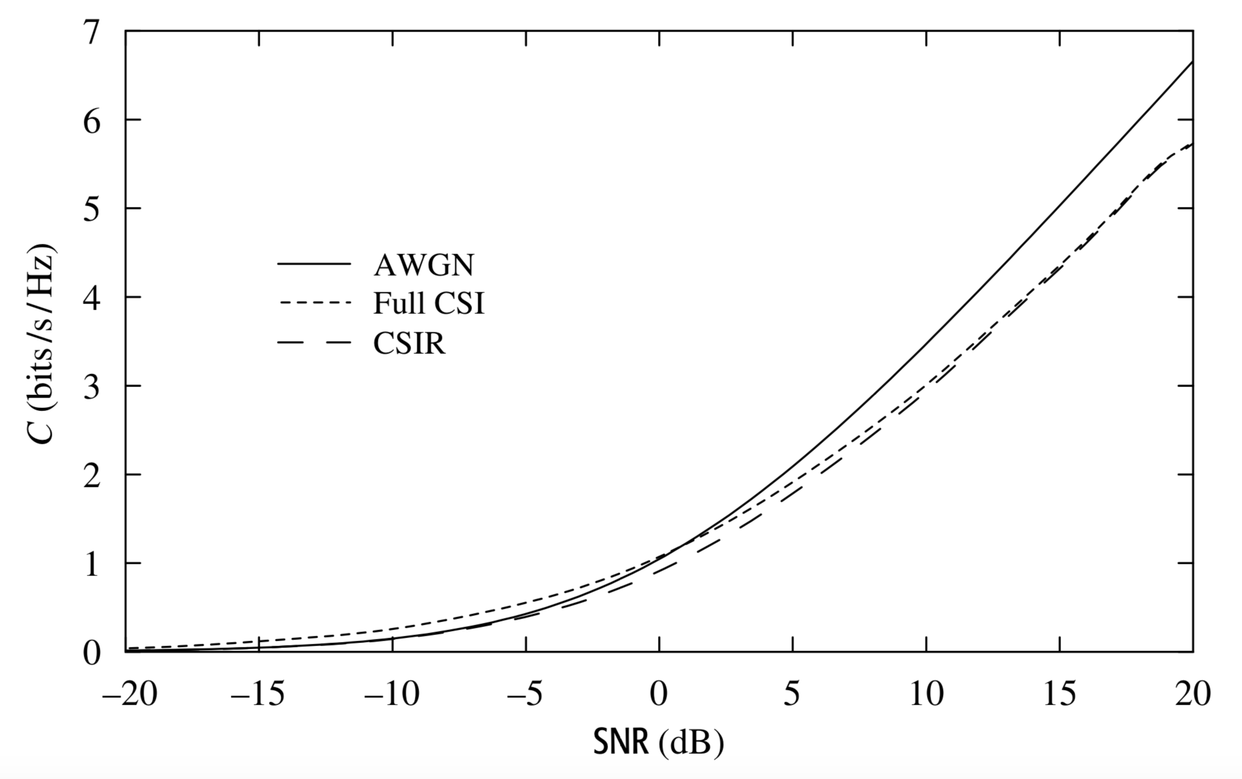
Low SNR Regime: A Information theory Perspective (1/2)
At low SNR regime, the Jensen’s loss becomes negligible and the capacities become approximately linear.
The reliable rate supported by the AWGN channel is much more sensitive to the received SNR at low SNR than at high SNR
At low SNR regime, the impact of fading is very significant.
For reasonably small outage probabilities, the outage capacity is only a small fraction of the AWGN capacity at low SNR
D. Tse and P. Viswanath, Fundamentals of Wireless Communication, Cambridge University Press, 2005

Slide 7
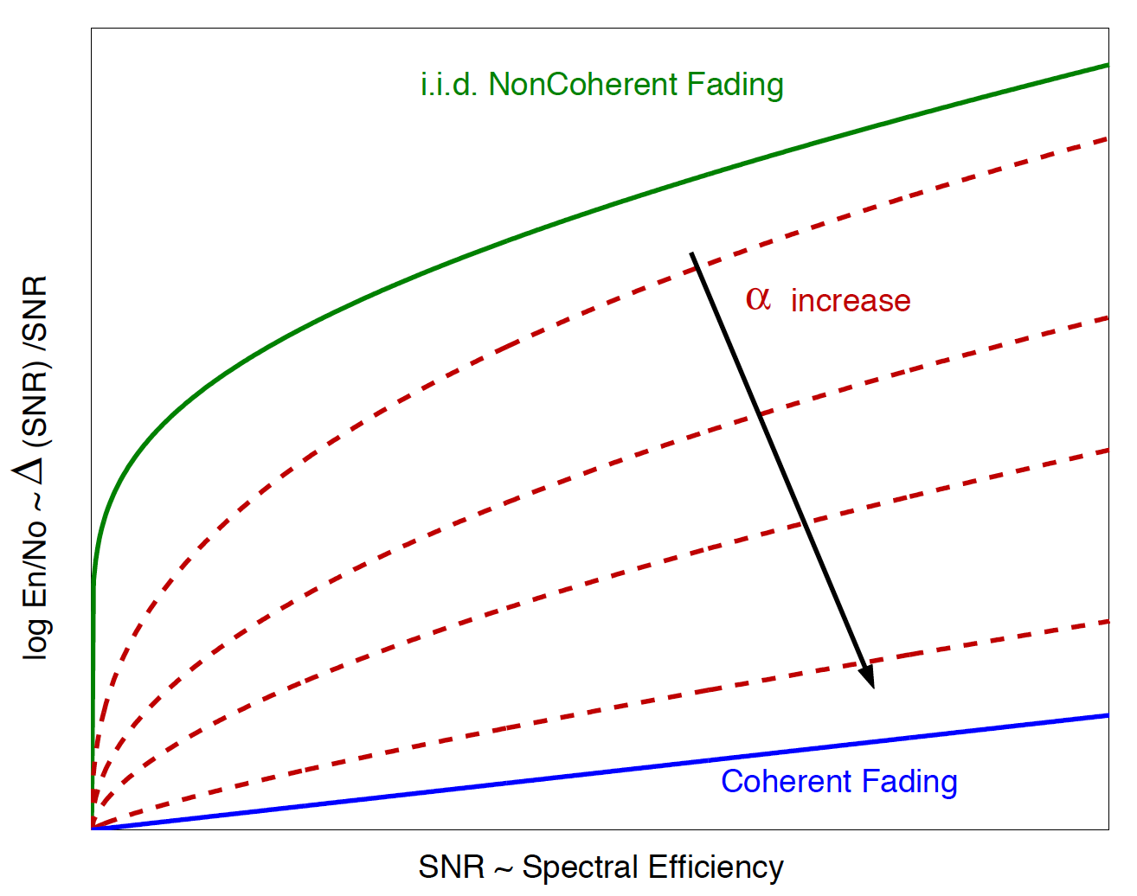
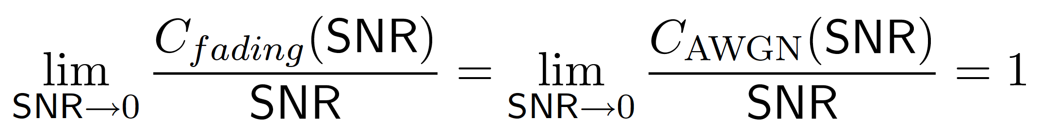
Low SNR Regime: A Information theory Perspective (2/2)
Bad News: “Channel capacity in the limit of vanishing SNR per degree of freedom is known to be linear in SNR for fading and non-fading channels, regardless of channel state information at the receiver (CSIR).”
Good News: “although a near linear capacity can be achieved in both cases eventually at low enough SNR, this limit is approached much more slowly for the non-coherent case.”
L. Zhang, D. Tse and M. Medard, Channel Coherence in the Low SNR Regime, IEEE Trans. Information Theory, vol. 53, no. 3, pp. 976-997, March 2007

Slide 8
Error sources for OTDOA Systems
Error Sources | GNSS Positioning | LTE OTDOA
transmitter clock | 1.5 m | 15 m
transmitter antenna coordinate error or satellite orbit error | 2.5 m | < 3 m
ionospheric & tropospheric delays | 5.5 m | N/A
signal measurement accuracy | 0.3 m | 40 m when SINR > -13 dB
multipath excess delay | 0.6 m | 30 m in suburban
GDOP |  | 0.9
Sources: Trimble, Novatel and Qualcomm

Slide 9
Accuracy Budget Example
Error Sources | Absolute GPS |  | Differential GPS
 | P Code | L1 C/A Code | P Code | C/A Code
Satellite Clock & Ephemeris Errors | 3.9 | 3.9 | 0 | 0
Ionospheric Delay | 3.1 | 9 | 0 | 0
Tropospheric Delay | 2.0 | 2.0 | 0.15 | 0.15
Receiver Noise and Resolution | 1.1 | 11.1 | 1.1 | 11.1
Multipath | 1.2 | 12 | 1.2 | 12
Other |  |  | 0 | 0
*Selective Availability |  | 30 | 0 | 0
Total System Error 1σ | 5.6 | 35.6 | 1.3 | 16
Position Error PDOP = 2.92 | 16.3 m | 104 m | 3.8 m | 48 m
R. M. Kalafus, Vilcans, N. Knable, “Differential operation of Navstar GPS”, Navigation Vol. 30, No. 3, 1983

Slide 10
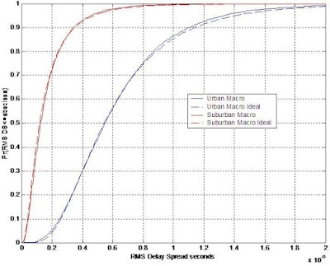
Multipath Delay Spread
In [1], Sousa, et. al., reported the 90th percent rms delay spread to be 1.2 μs in suburban Toronto.
In [2], Ling, et. al. observed that the 90th percent rms delay spread was 1.7 μs in Lakehurst NAES, New Jersey.
In [3], Baum reported the 77th percent rms delay spread was 1 μs, the 94th percent rms delay spread was 2 μs in Rolling Meadows, Chicago.
[1] E. Sousa, V. Jovanovic, C. Daigneault, “Delay spread measurements for the digital cellular channel in Toronto”, IEEE Trans. on Vehicular Technology, Nov 1994 [2] J. Ling, D. Chizhik, D. Samardzija, R. Valenzuela, “Wideband and MIMO measurements in wooded and open areas”, Lucent Bell Laboratories, [3] K. Baum, “Frequency-Domain-Oriented Approaches for MBWA: Overview and Field Experiments”, Motorola Labs, IEEE C802.20-03/19, March 2003

Slide 11

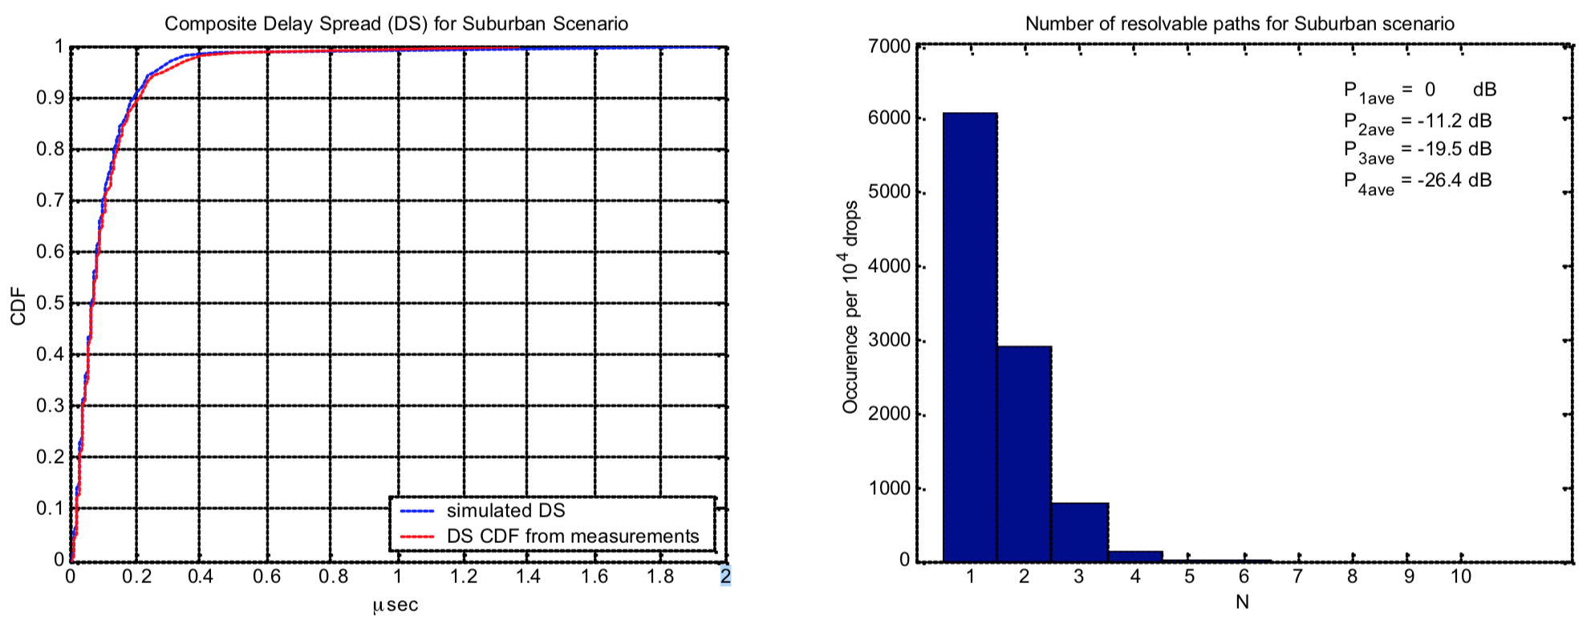
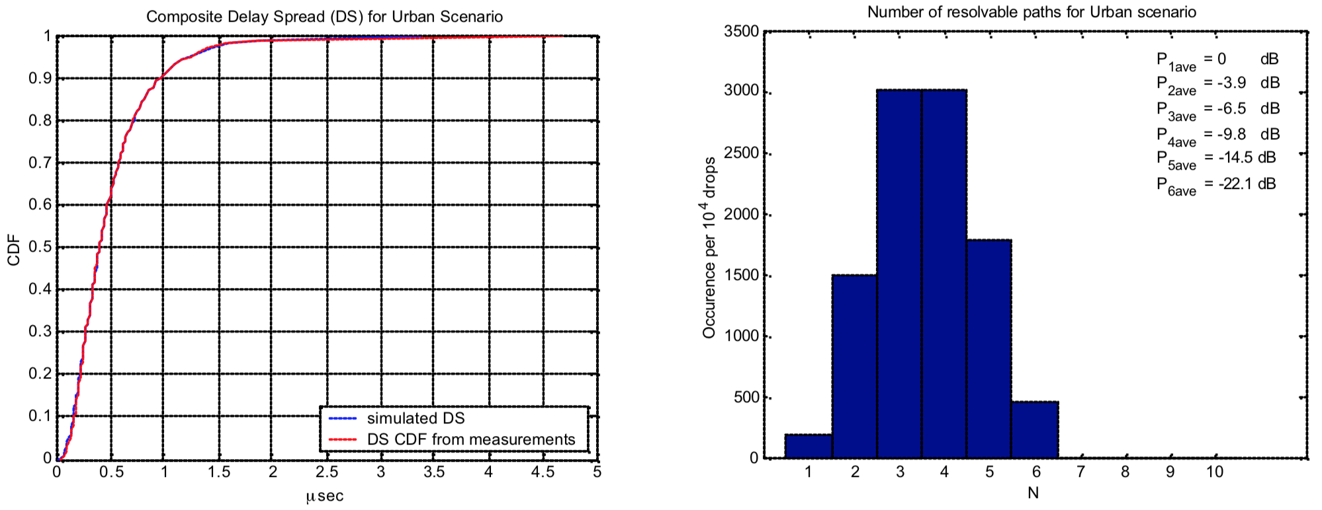
Statistics for 3GPP/3GPP2 Macro Channels
3GPP & 3GPP2 system level assumptions
The Chip rate is 3.84Mcps.
Only the paths with power higher than –15dB relative to the strongest path are recorded.
The shown statistics are the non-power weighted ones

Slide 12
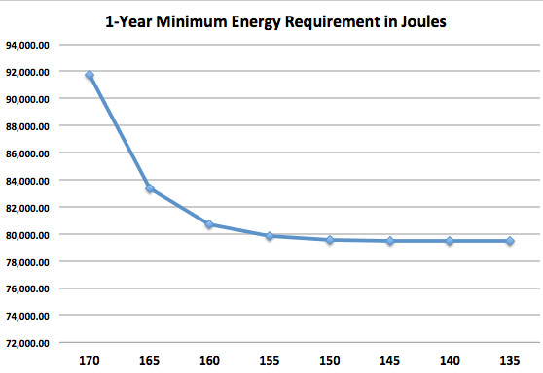
Energy Budget
Energy Budget models how much energy is consumed in each stage of the total process, particularly considering L1 signal processing and L2 protocol stack.
It is no surprising that for many wireless system, there are tradeoffs between energy budget and link budget, sensitivities, response time, battery life, etc.

Slide 13
Example: LTE State Machine for Energy Modelling and battery life estimation
Tracking Area Update
RRC Connected
RACH RRC Connection Setup
Out of Tracking Area
Cell Evaluation and Reselection
In the same TA
Store the cell info
Connection Release
Cell Reselection
Criteria match
P-RNTI Not Match
Cell Reselection
Criteria match
Connection Release
Paging Occasion
w/Sintrasearch
PDCCH Monitor Serving Cell Mea & Intra Freq Mea
PDCCH/PDSCH Rx PUCCH/PUSCH Tx
Idle Mode
DRX Deep Sleep
UE initiated Service Request
P-RNTI Match
Network Attached
Paging Message Serving Cell Mea & Intra Freq Mea
S-TMSI Not Match
RACH and RRC Conn. Setup and Reconfig
S-TMSI Match

Slide 14
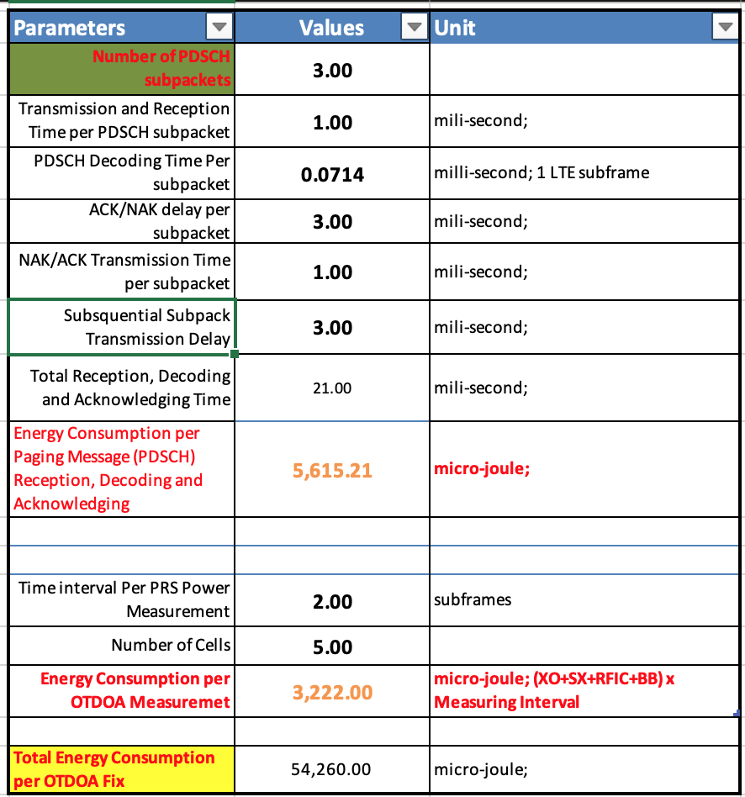
Energy modelling example
GPS RF Power: 39.6 mw
Deep-Sleep: 25 uw
Micro-Sleep (XOSC+RSX+CLCKGEN): 44.6 mw
Active (XOSC+RSX+CLCKGEN+1xRx): 101.4 mw
BBIC PLL Power: 0.5 mw
BBIC PLL warm-up: 3ms
LTE Baseband: 200 mw
Tx PA: 1000 mW in average
Battery: shelf time, engineering loss, power supply efficiency, headroom, etc.

Slide 15
Thank You Very Much for Your Time!

